Slide 1
Team Fundraising
Setup
Quick Guide
2022-03-20

Slide 2
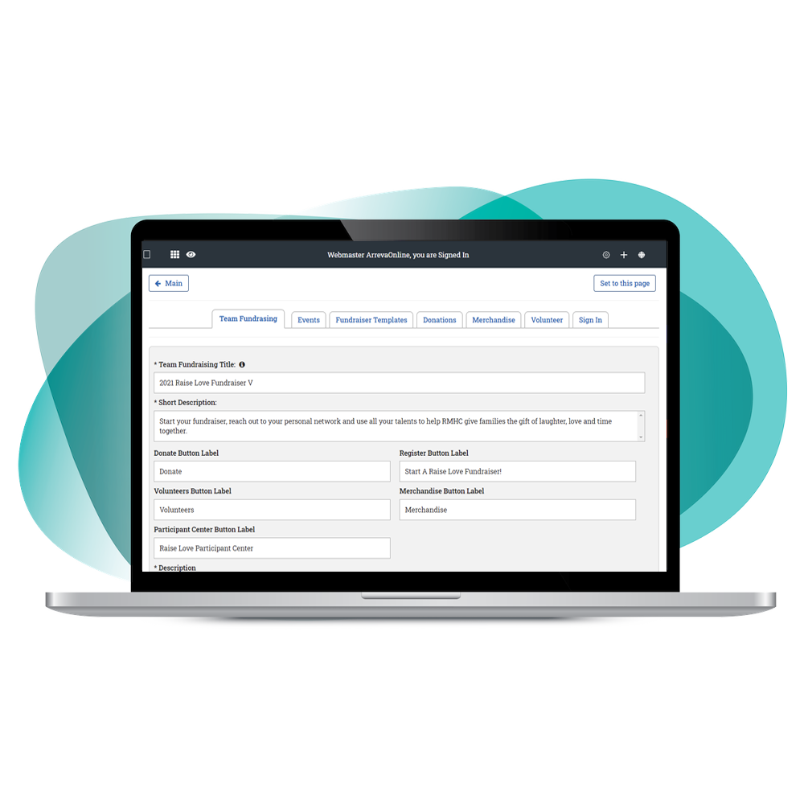
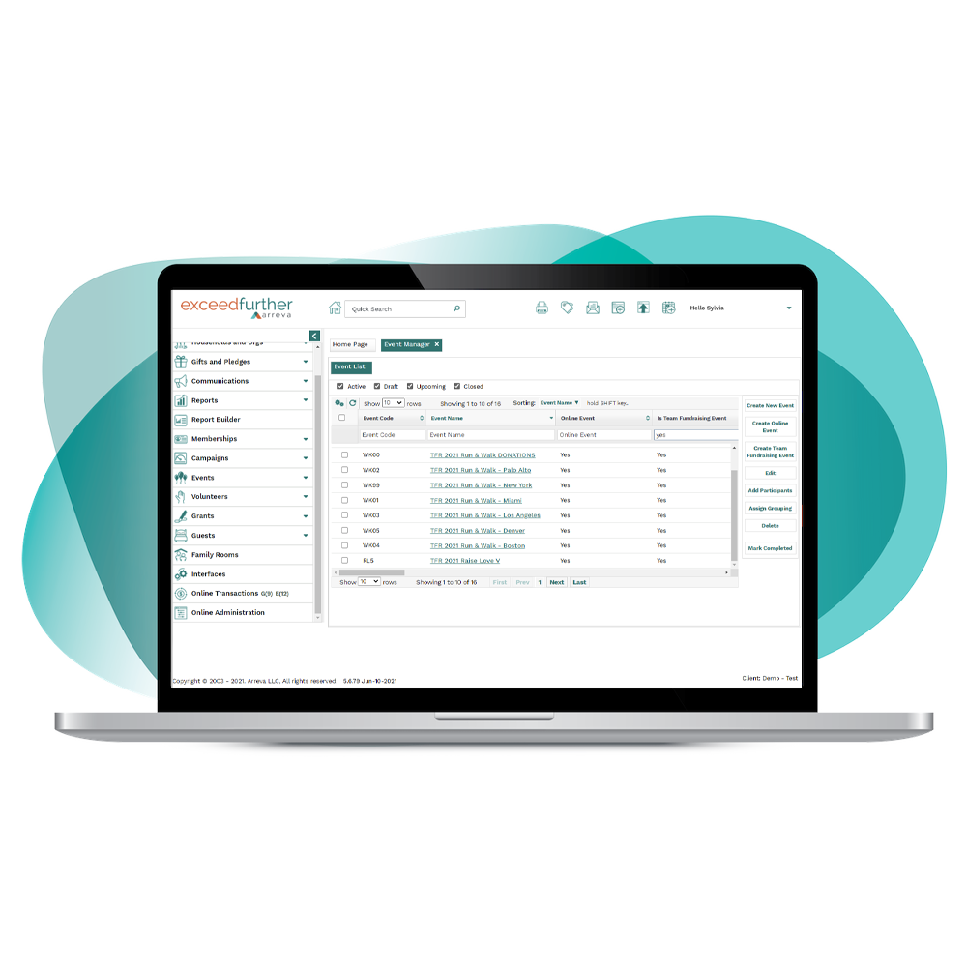
Team Fundraising: Easy Setup
Always start by planning and creating your Team Fundraising Event in ExceedFurther
Then go to Online Administration to personalize the Team Fundraiser for public use

Slide 3
1
Planning
Event(s)
Location, Dates, Reasons, Funds
REGISTRATION OPTIONS (TO’s)
Create/Join/Independent
Event(s)
Location, Dates, Reasons, Funds
REGISTRATION OPTIONS (TO’s)
Create/Join/Independent
Event(s) in EF DRM
Location, Dates, Reasons, Funds
REGISTRATION OPTIONS (TO’s)
Create/Join/Independent
2
Important Questions
Virtual and/or Live?
Multiple locations, different dates?
Participation options?
Goal?
Images/Content
View results → Reasons, funds, udfs
Team Fundraiser Setup in
EF OnlineAdministration
TFR Defaults
Team Fundraisers Template
Participant Fundraisers Template
Events
Donation page
3

Slide 4
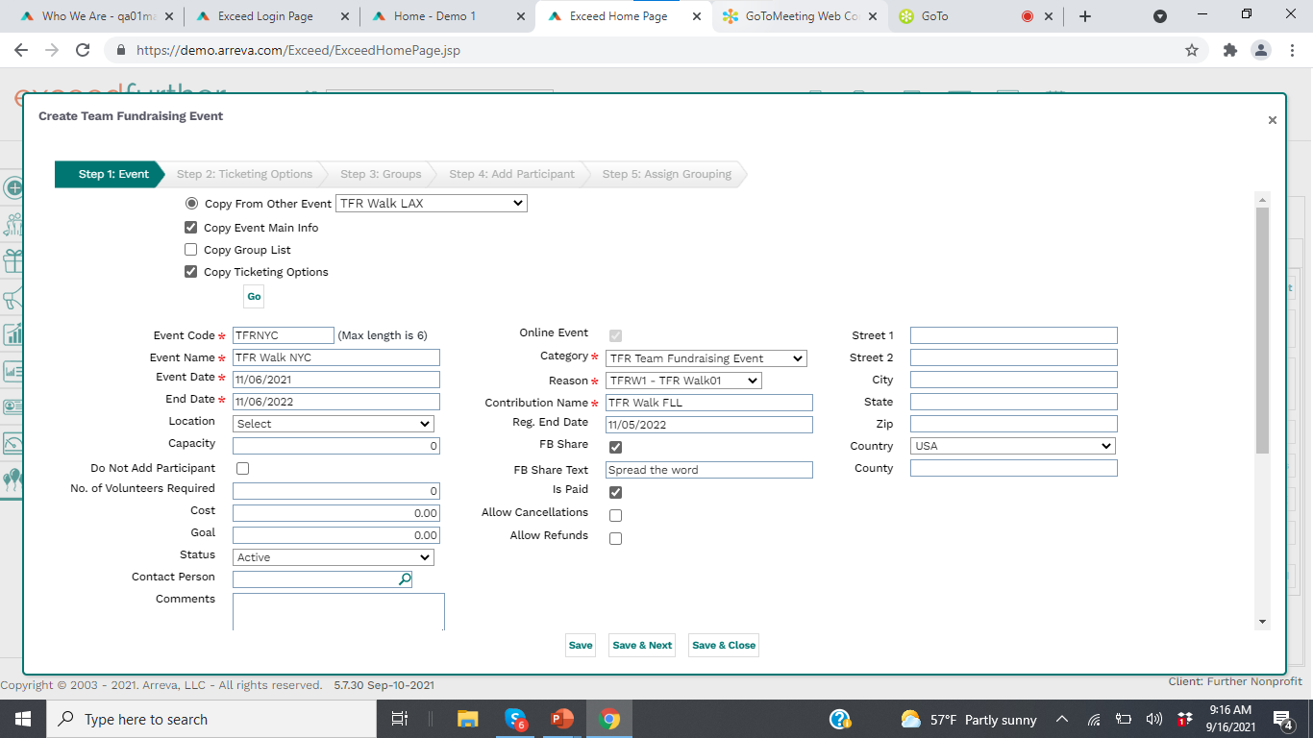
Events - DRM
Reasons/Funds/ Categories
Create TFR Event
Copy/adjust if more than one event needed (different locations, different dates, different schools, etc)
2
Create Event(s) in EF DRM

Slide 5
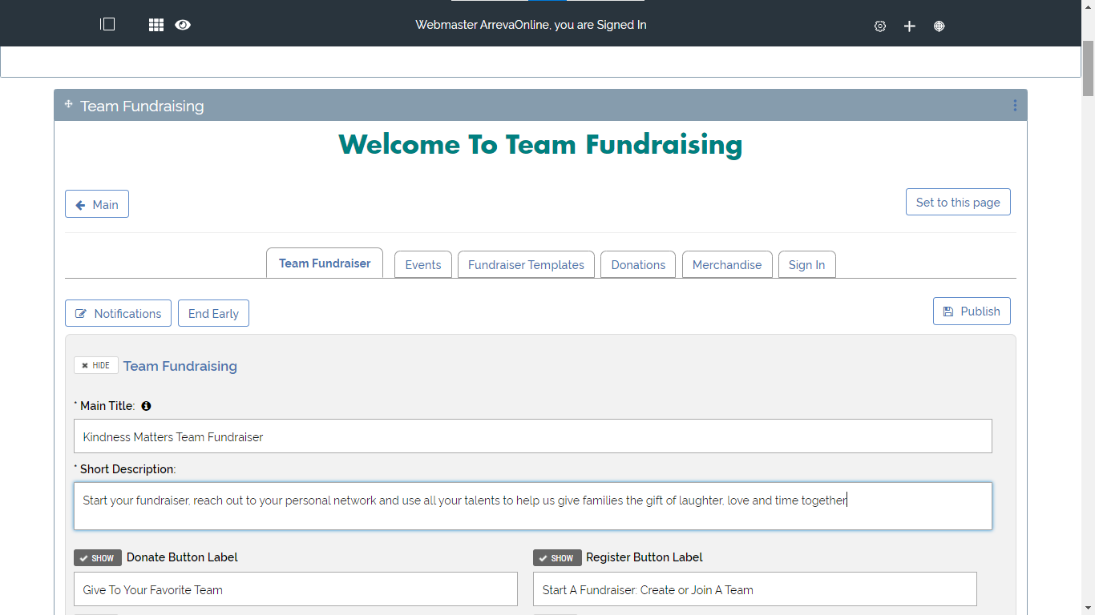
3
TFR Setup in
EF Online Administration
Online Admin
TFR Defaults
Team & Participant Templates
Events
Donation Webpage

Slide 6
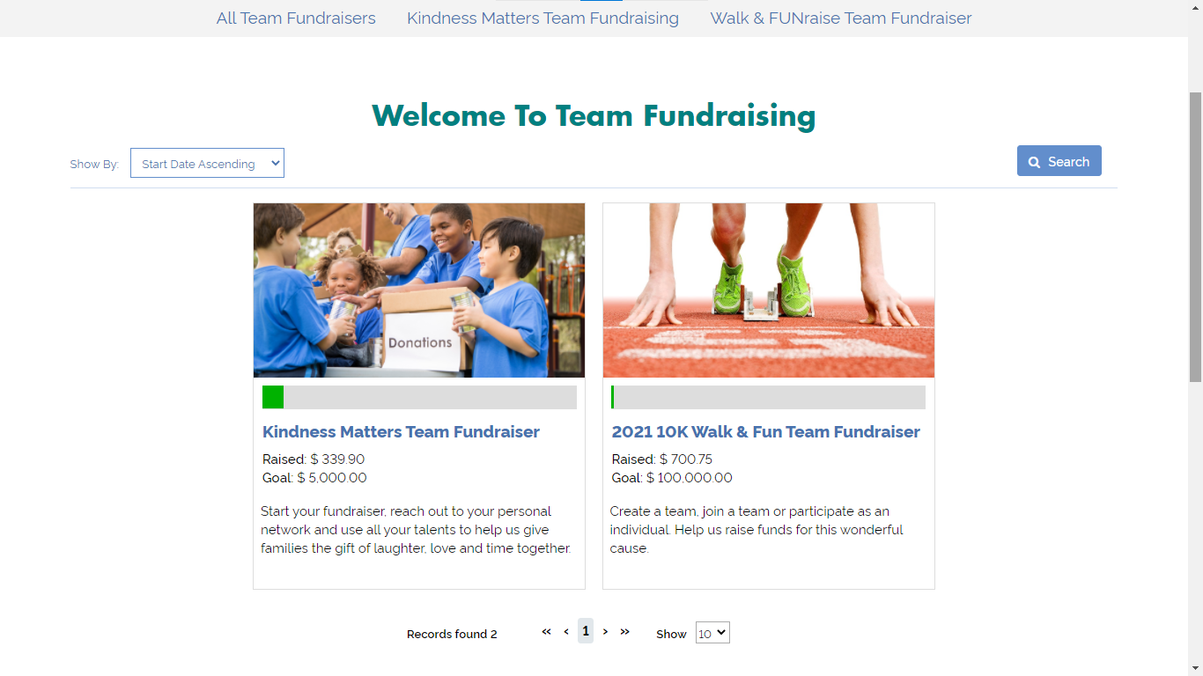
Ready!
View & confirm all ok
Setup a dedicated page (URL)
Communications (Internal announcement, automatic notification to Team Captains,, Tell A Friend, etc)
Launch

Slide 7
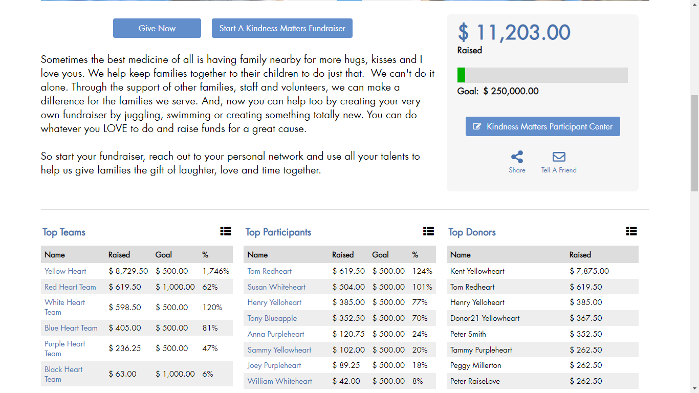
View Results Real-Time
Track Results
Leaderboards and goal bar updated instantly as gift are entered.
Manual entries for admin user to add other gifts show instantly.

Slide 8
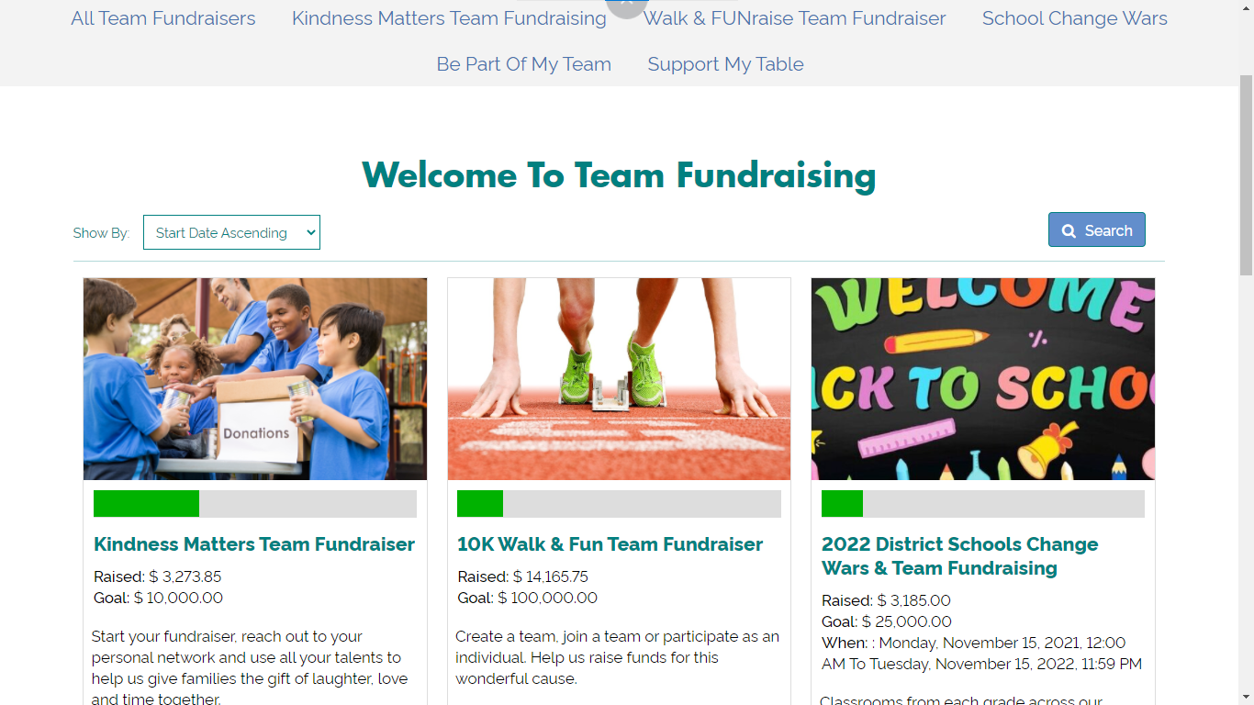
View All or set a separate webpage for each Team Fundraiser
1 or more Team Fundraisers running at the same time

Slide 9
Online Transactions into your DRM automatically!
All gifts from Team Fundraising (registrations + donations + fundraising pages donations) ready for matching & reporting!
Match & Report

Slide 10
Team Fundraising
Support
Help and guide our clients on setup of their first Team Fundraiser, with transfer of knowledge

Slide 11
Team Fundraising
LIVE EXAMPLE

Slide 13
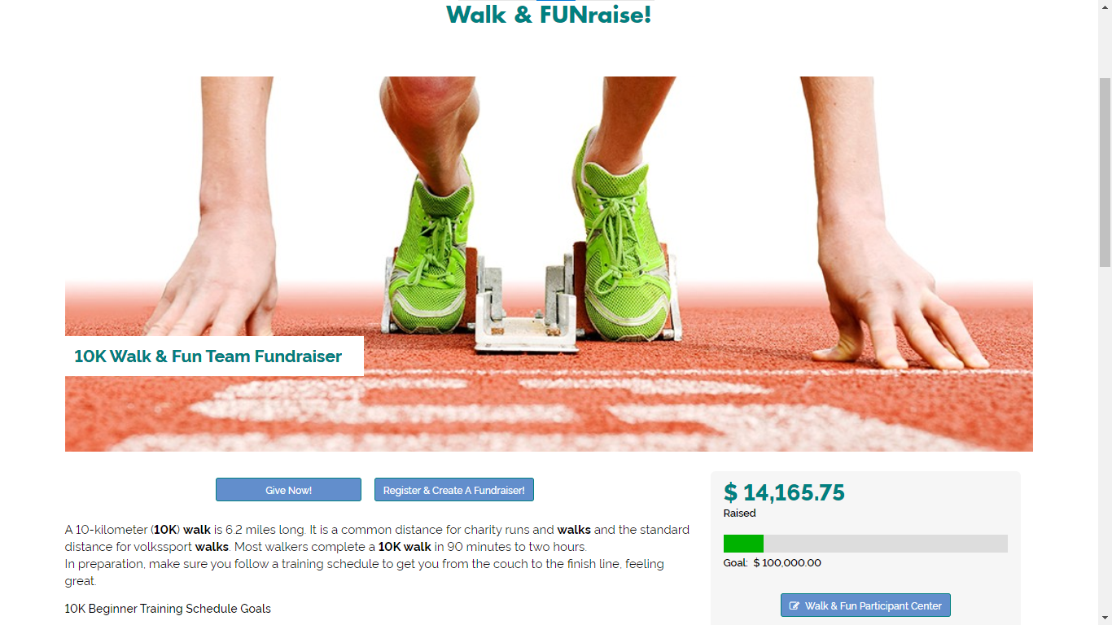

Slide 14
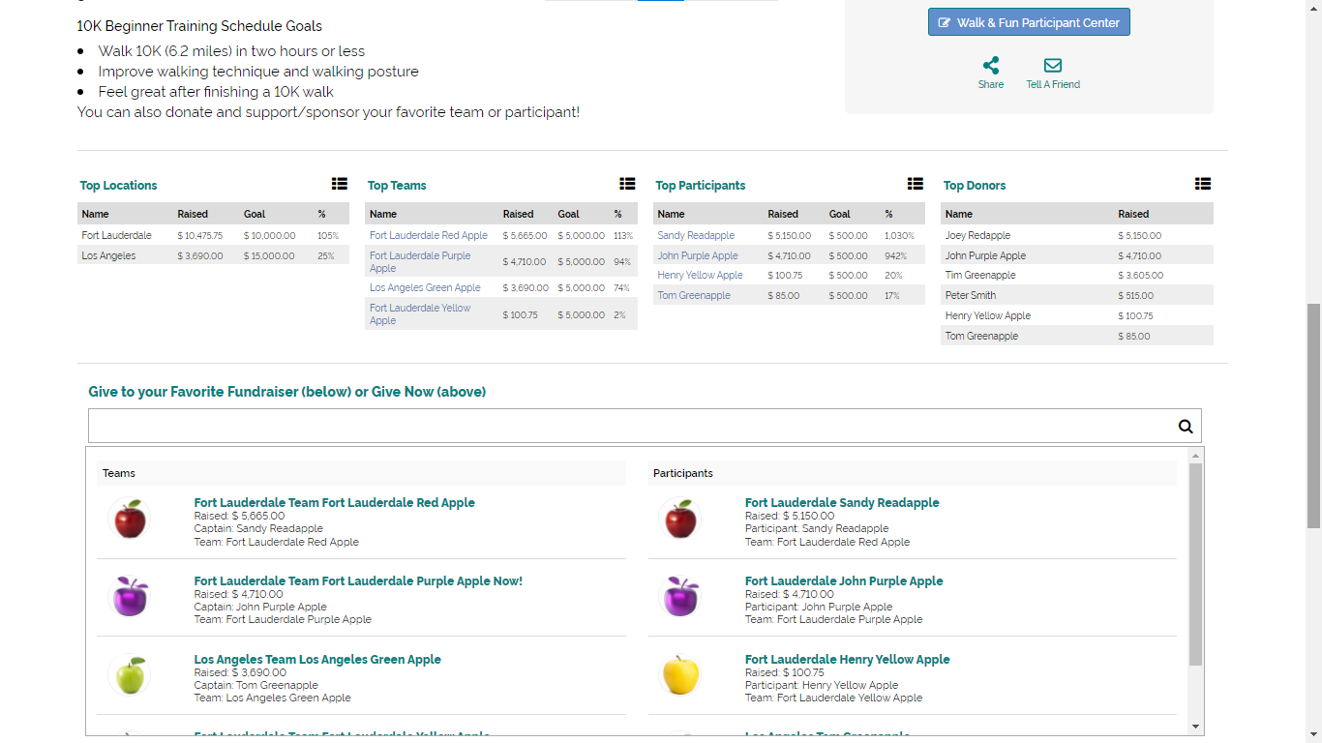
Ways To Participate
All options can be personalized with
Show/Hide feature
Register to Create/Join Team
Register Independently
Plus create a personal fundraising page
Give/Donate and support a team or individual

